Slide 2
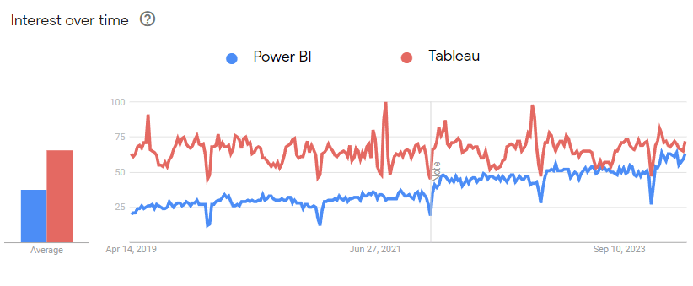

Slide 3
Power Bi Desktop
Power query
Modelling
DAX
Visual
Power Bi Services
Power Bi Mobile

Slide 4
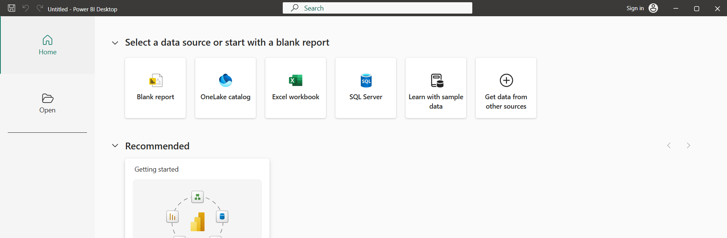
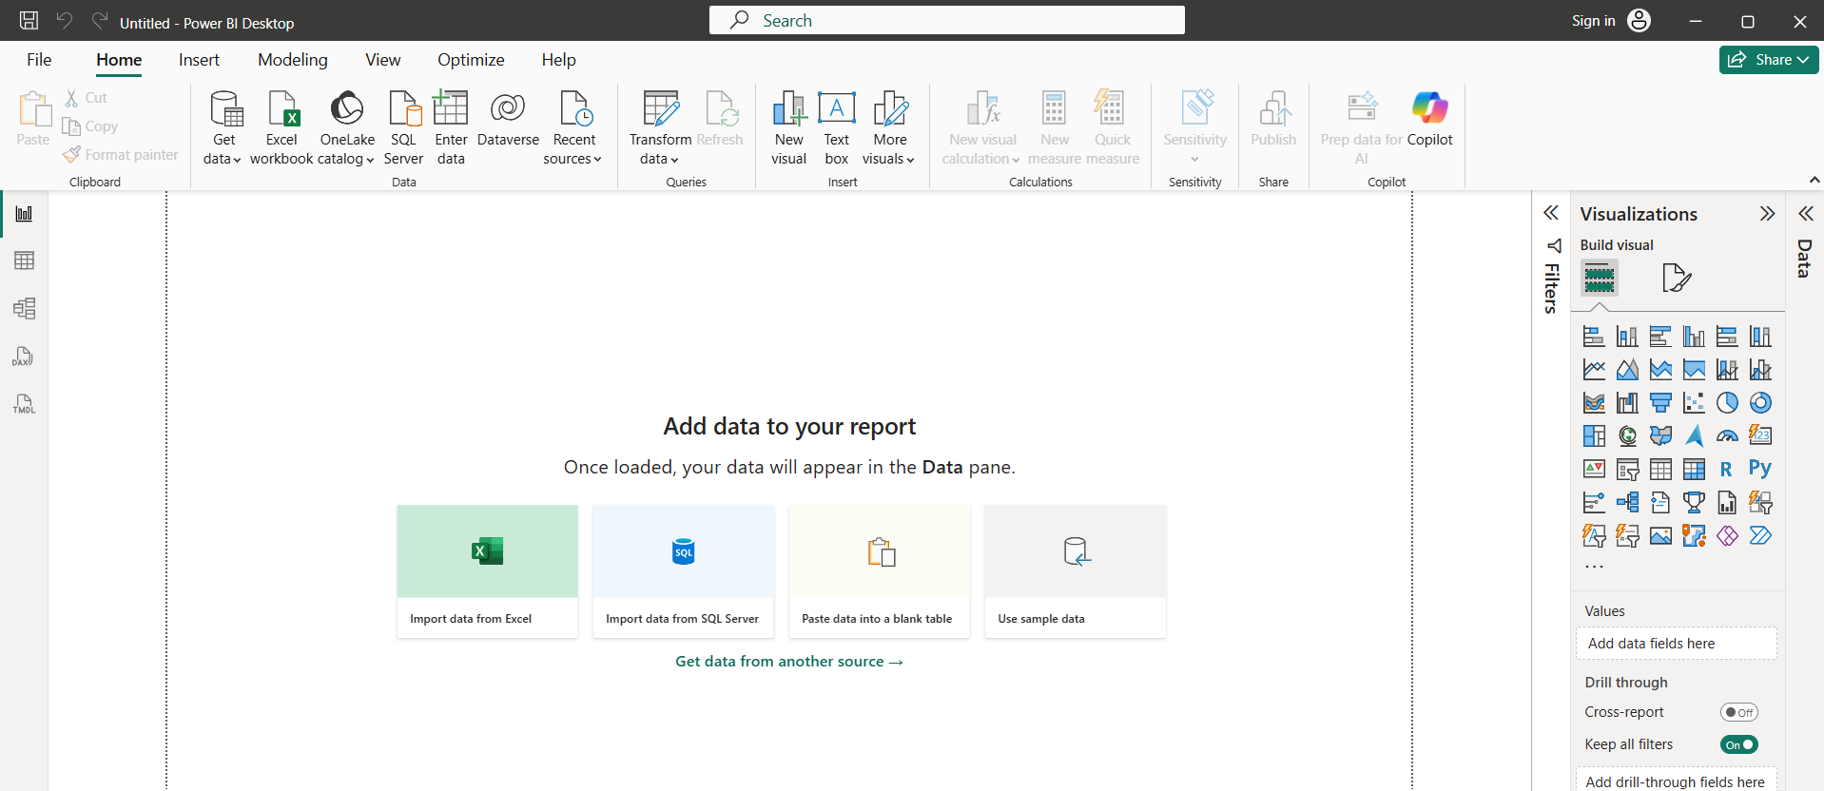

Slide 5
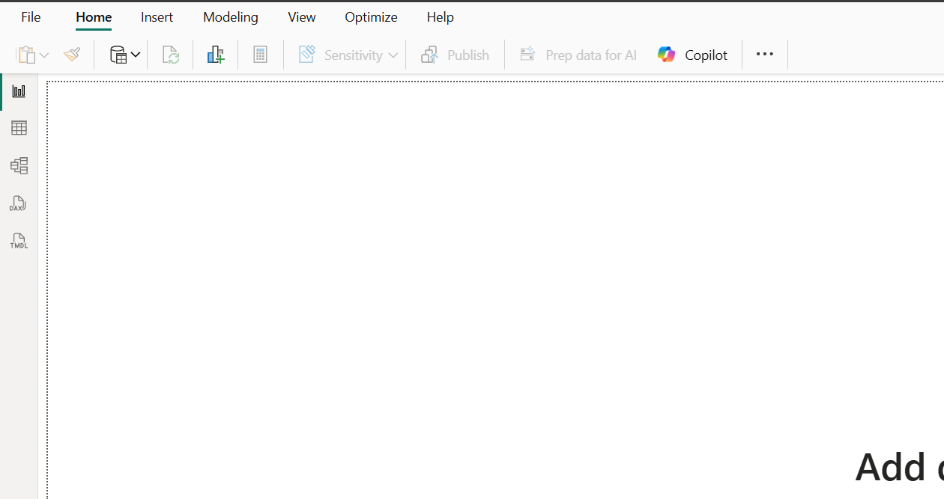
Report View (Bar chart icon): Used to create and view your report visualizations.
Table View (Grid icon): Used to view and manage the data within your tables.
Model View (Relationship diagram icon): Used to manage relationships between different data tables.
DAX Query View (Document icon with "DAX"): Used to write and run DAX (Data Analysis Expressions) queries.
TMDL View (Document icon with "TMDL"): Used for working with Tabular Model Definition Language files.

Slide 6
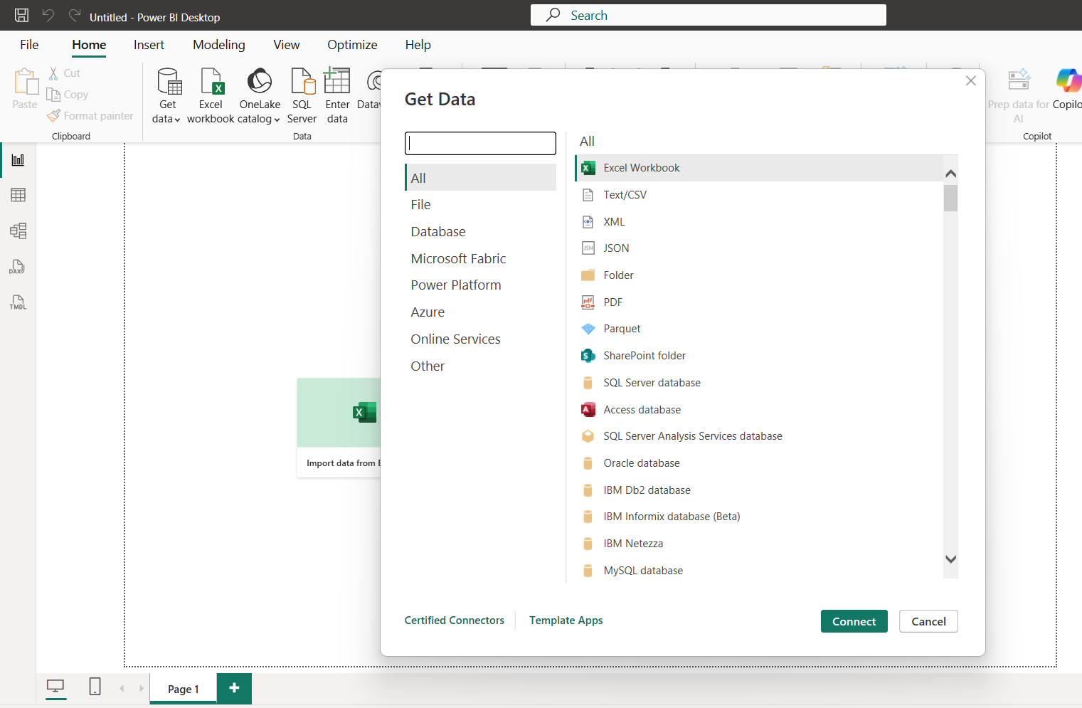

Slide 7
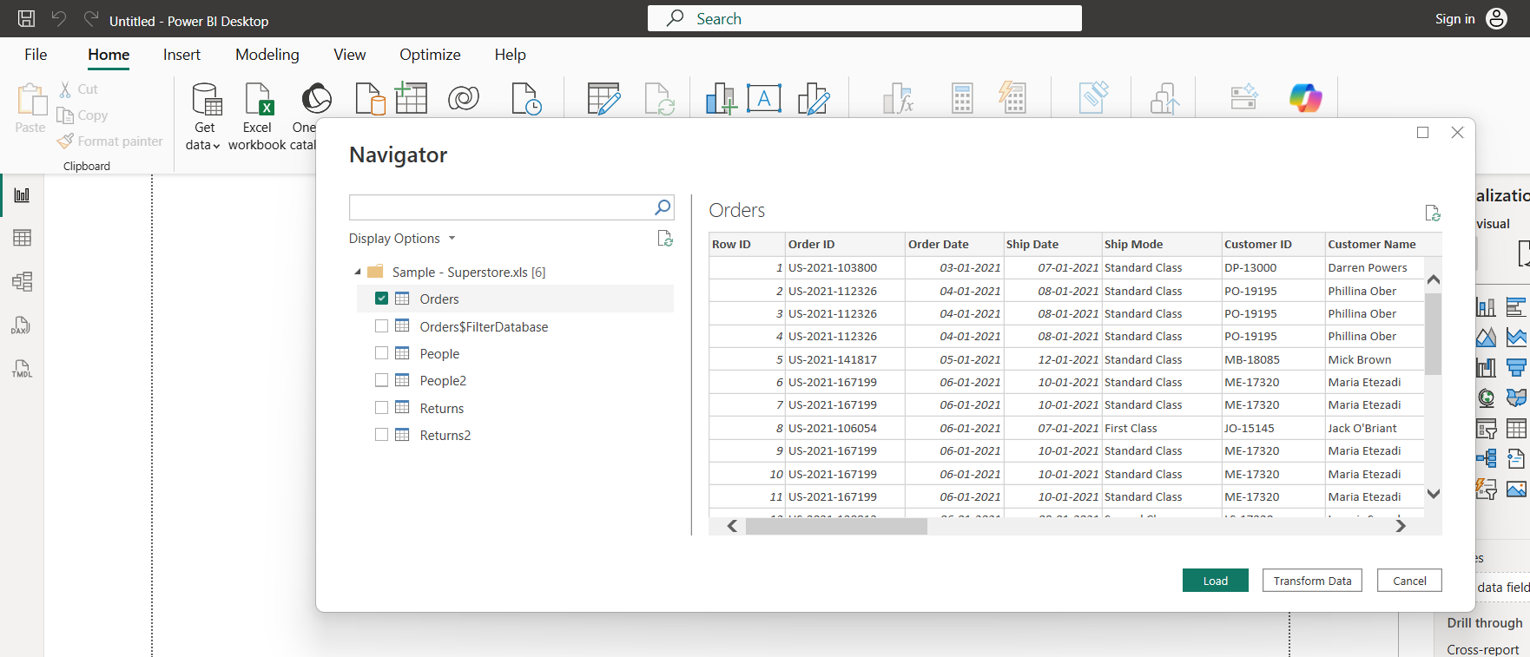

Slide 8
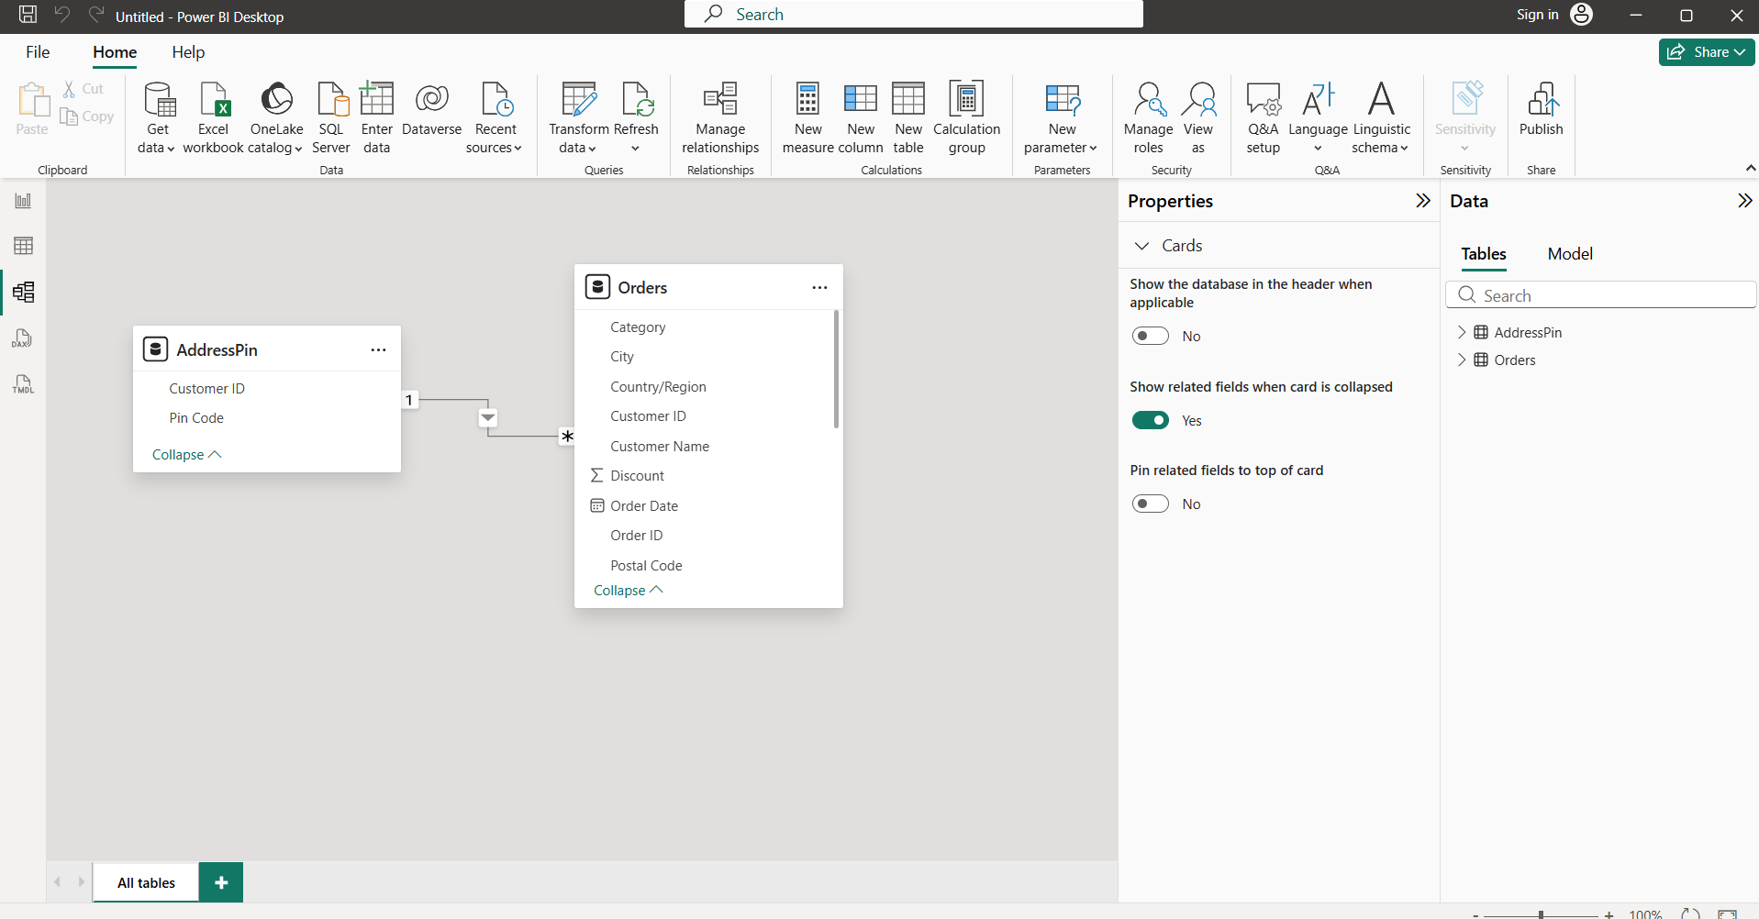
Model View

Slide 9
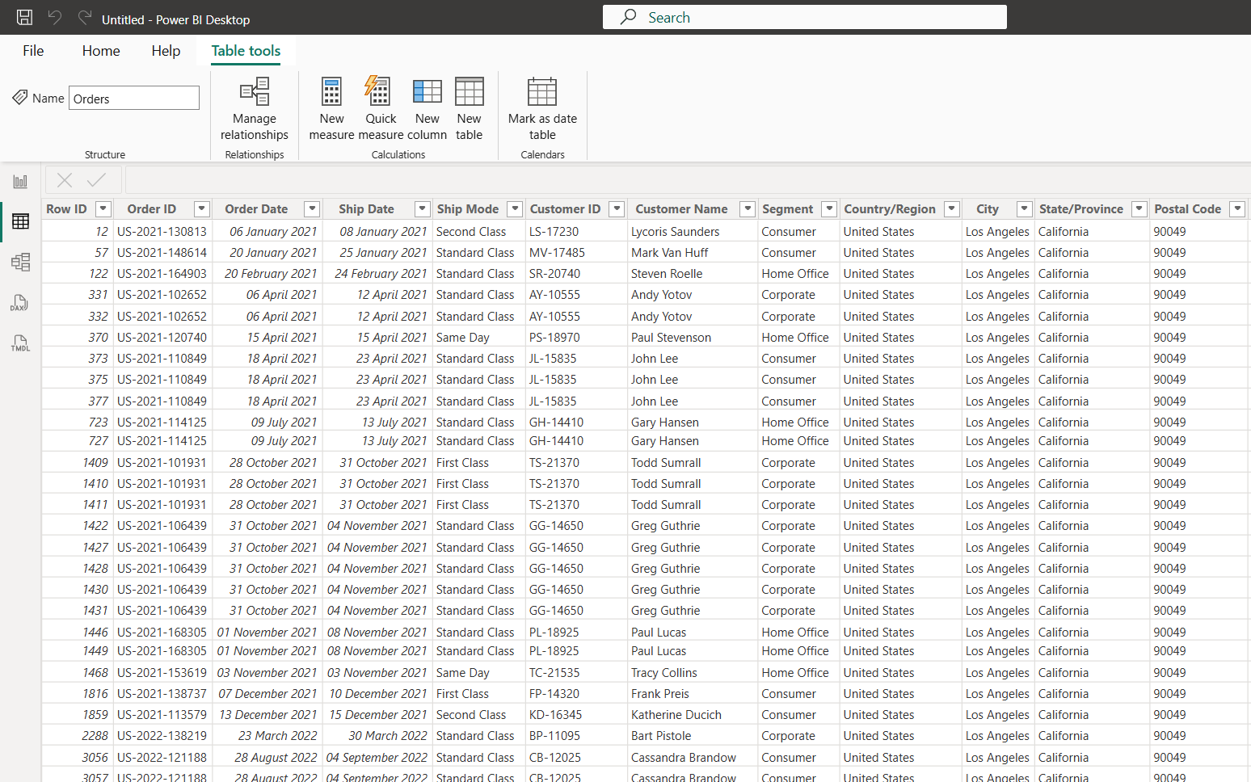
Data

Slide 10
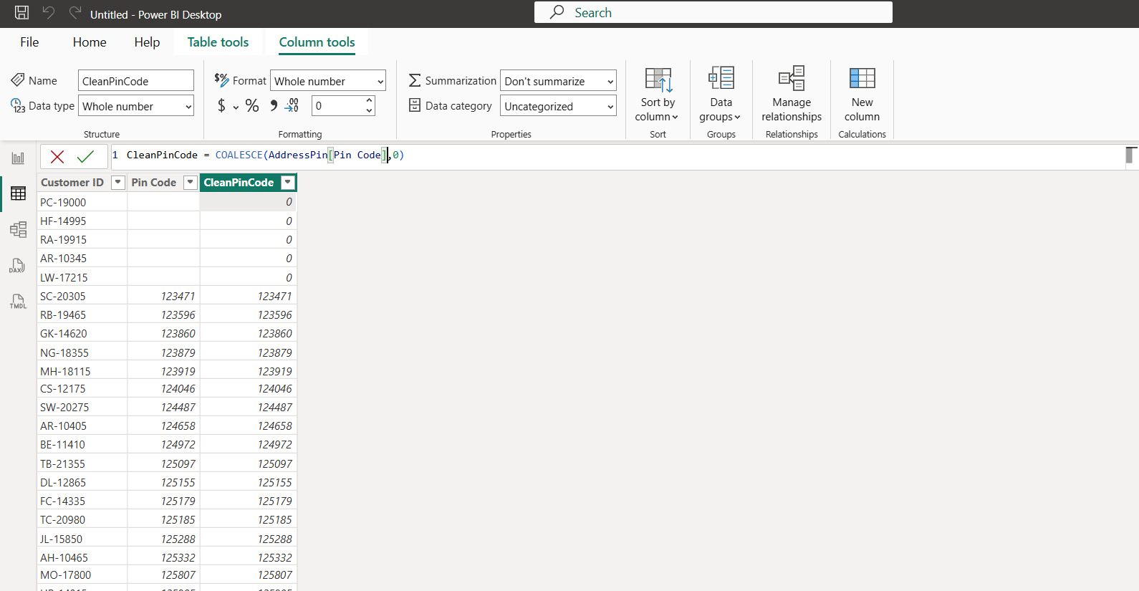
DAX

Slide 11
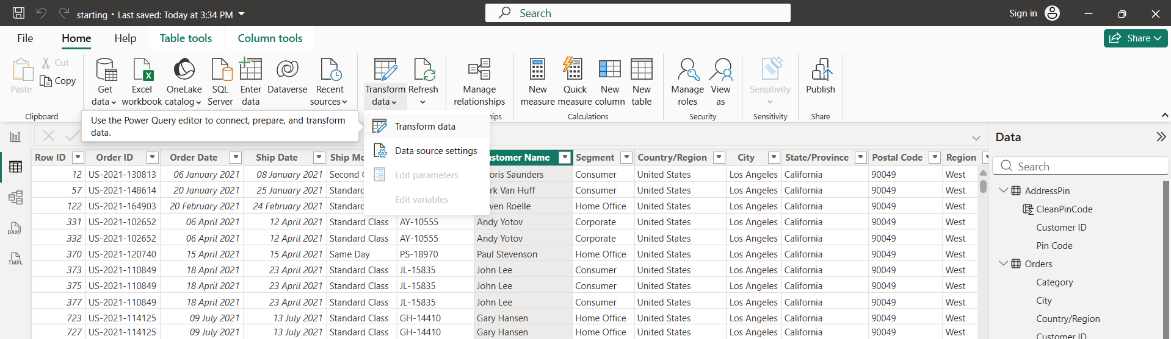
Transform

Slide 13
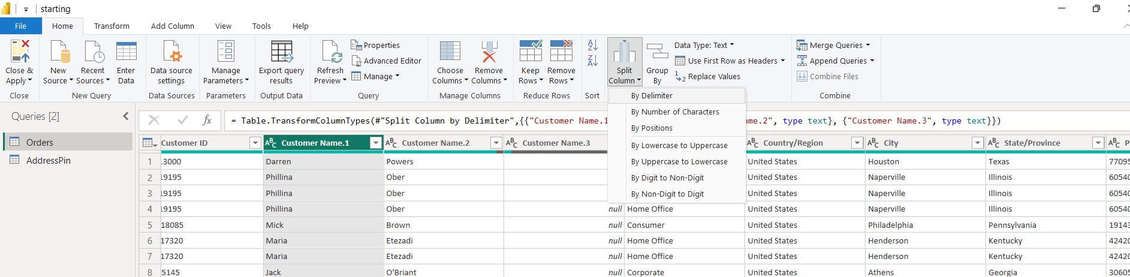
Power Query

Slide 14
Data Modelling
Relationships Cardinality & Cross Filter Direction :
Star Schema vs. Snowflake Schema: Structural organization of Fact and Dimension tables.
Creating & Managing Relationships: Active vs. inactive relationship paths.
Date Table Creation: Generating continuous calendar dimensions for Time Intelligence functions.
Hierarchies: Parent-child drill-down paths (e.g., Year > Quarter > Month > Day).

Slide 15
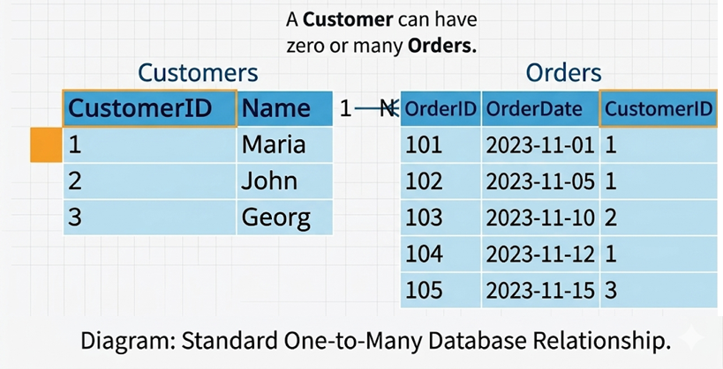
Relationships:
One-to-many
One to One
Many to Many
One-to-many

Slide 16
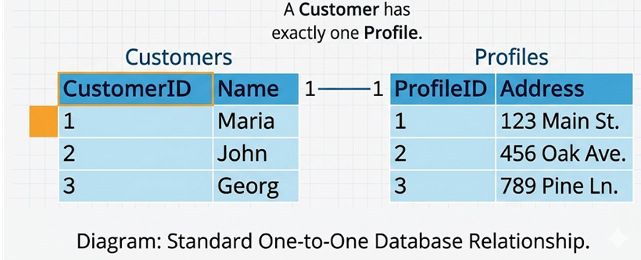
One-to-One

Slide 17
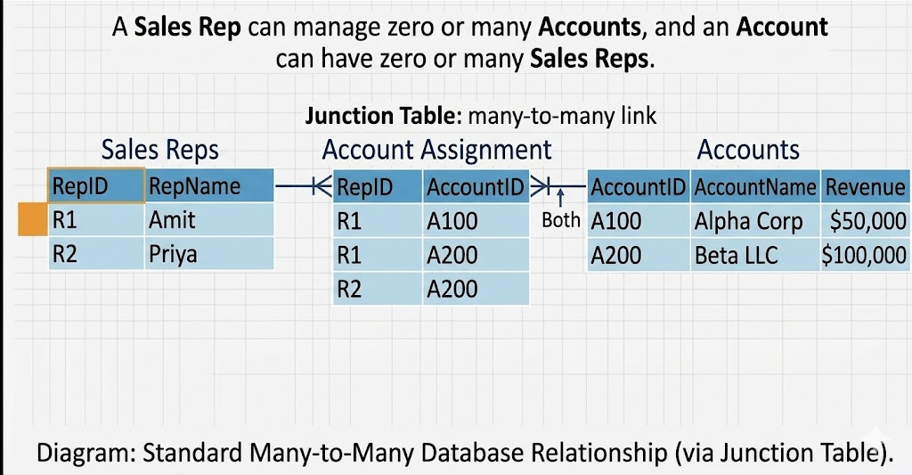
Many to Many

Slide 18
Star Schema vs. Snowflake Schema:
Before we go for Star Schema and Snowflake Schema 1st we need to understand what is Fact Table and Dimension Table

Slide 19
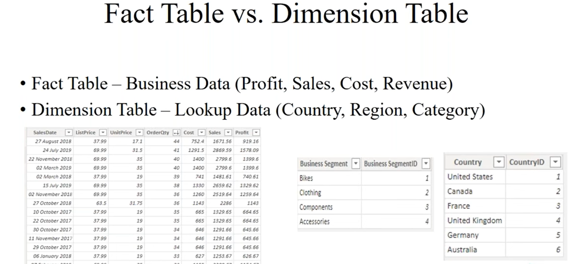
Fact Table: Stores quantitative, measurable metrics and foreign keys, recording specific business events or transactions (e.g., sales revenue, quantity sold).
Dimension Table: Stores descriptive attributes and context about the facts, allowing users to filter, group, and label data (e.g., customer names, product categories, dates).

Slide 20
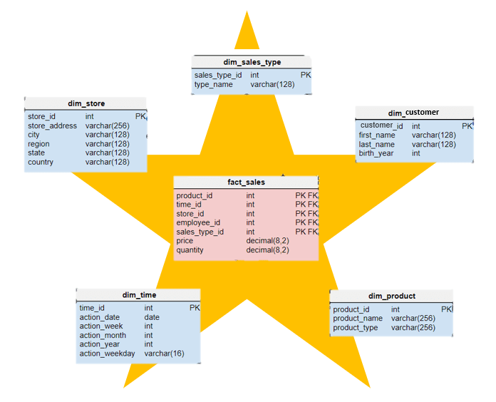
Star Schema
Every Dimension table is connected to the Fact Table.

Slide 21
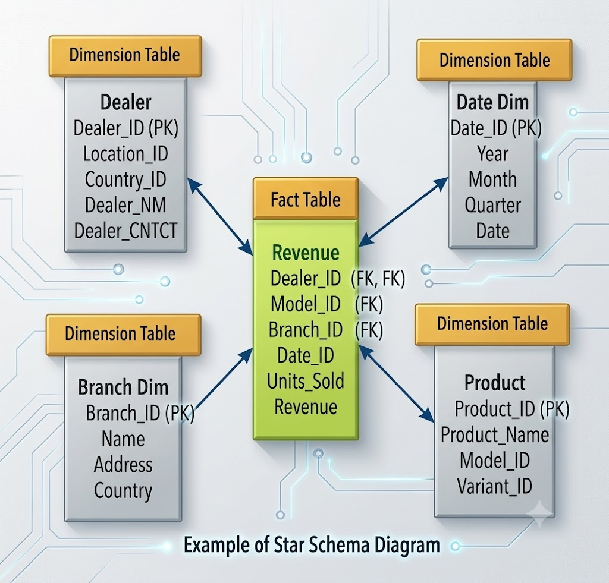
Every Dimension table is connected to the Fact Table.

Slide 22
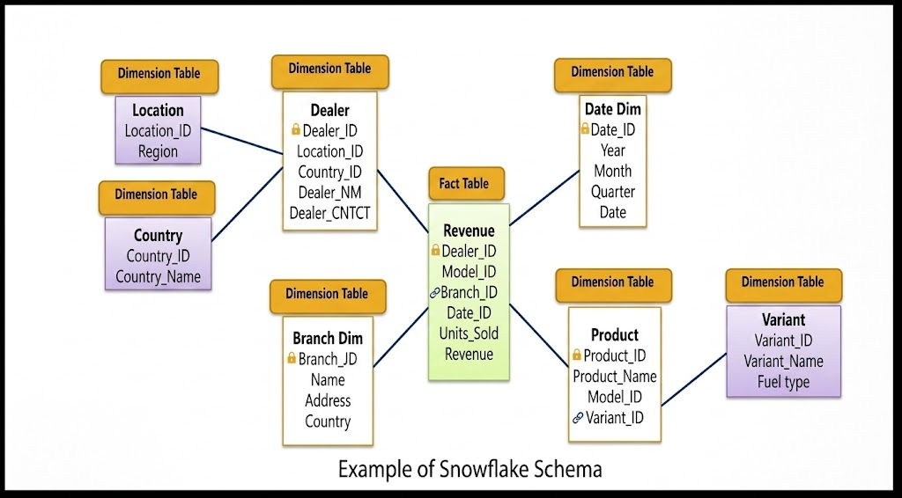
Snowflake Schema:

Slide 23
Dax
There are more than 200 DAX functions. Some importat as below.
Aggregation functions
Aggregation functions return a scalar value applying an aggregation function to a column or to an expression evaluated by iterating a table expression.
Date and Time functions
Date and time functions help creating calculations based on dates and time.
Filter functions
Filter functions manipulate table and filter contexts.
Information functions
Information functions provide information about data type or filter context of the argument provided.
Logical functions
Logical functions act upon an expression to return information about the values or sets in the expression.
Aggregation functions: SUM, AVERAGE, MIN, MAX, COUNT
Date and Time functions: CALENDAR, DATEVALUE, DAY, MONTH, YEAR
Filter functions: CALCULATE, FILTER, ALL, ALLEXCEPT, RELATED
Information functions: ISBLANK, ISERROR, ISNUMBER, ISTEXT, USERNAME
Logical functions: AND, OR, NOT, IF, SWITCH

Slide 24
Aggregation functions
Aggregation functions return a scalar value applying an aggregation function to a column or to an expression evaluated by iterating a table expression.
Total_Sales = SUM(Sales[Amount])
Order_Count = COUNT(Sales[OrderID])
Average_Price = AVERAGE(Products[Price])
DistinctValue = DISTINCTCOUNT(Data[Beverage Brand])
Profit Margin % = DIVIDE([Profit], [Total Revenue])
Min
Max

Slide 25
Date and Time functions
Date and time functions help creating calculations based on dates and time.
DATE | TargetDate = DATE(2026, 06, 02)
DATEDIFF | DaysPassed = DATEDIFF(OrderDate, ShipDate, DAY)
DATEVALUE | ConvertedDate = DATEVALUE("2026-06-02")
DAY | DayNumber = DAY(Sales[InvoiceDate])
EDATE | TwoMonthsLater = EDATE(Sales[OrderDate], 2)
EOMONTH | MonthEnd = EOMONTH(Sales[OrderDate], 0)
HOUR | OrderHour = HOUR(Sales[Timestamp])
MINUTE | OrderMinute = MINUTE(Sales[Timestamp])
MONTH | MonthNumber = MONTH(Sales[OrderDate])
NOW | CurrentTimestamp = NOW()
QUARTER | CurrentQuarter = QUARTER(Sales[OrderDate])
SECOND | OrderSecond = SECOND(Sales[Timestamp])
TIME | ShiftStart = TIME(9, 0, 0)
TIMEVALUE | ConvertedTime = TIMEVALUE("13:30:00")
TODAY | CurrentDate = TODAY()
WEEKDAY | DayOfWeek = WEEKDAY(Sales[OrderDate], 2)
WEEKNUM | WeekOfYear = WEEKNUM(Sales[OrderDate])
YEAR | OrderYear = YEAR(Sales[OrderDate])

Slide 26
Information functions
Information functions provide information about data type or filter context of the argument provided.
ISBLANK | ISBLANK(Sales[Discount])
ISERROR | ISERROR(Sales[TotalAmount] / Sales[Quantity])
ISNUMBER | ISNUMBER(Sales[PostalCode])
ISTEXT | ISTEXT(Sales[ProductCode])
HASONEVALUE | HASONEVALUE(Product[Category])
HASONEFILTER | HASONEFILTER(Product[SubCategory])
NONBLANKROWCOUNT | RowCount = NONBLANKROWCOUNT(Customers)
USERNAME | CurrentUser = USERNAME()
USERPRINCIPALNAME | UserEmail = USERPRINCIPALNAME()

Slide 27
Logical functions
Logical functions act upon an expression to return information about the values or sets in the expression.
AND | AND(Sales[Amount] > 100, Sales[Region] = "West")
OR | OR(Sales[Quantity] > 10, Sales[Discount] > 0.1)
NOT | NOT(Sales[Status] = "Cancelled")
IF | IF(Sales[Amount] >= 500, "High Value", "Standard")
SWITCH | SWITCH(Sales[RegionCode], 1, "North", 2, "South", 3, "East", 4, "West", "Unknown")
IFERROR | IFERROR(Sales[Revenue] / Sales[Units], 0)
COALESCE | COALESCE(Sales[AltPhone], Sales[HomePhone], "No Number")
FALSE | SetFalse = FALSE()
TRUE | SetTrue = TRUE()

Slide 28
Filter & Calculate functions
Filter functions manipulate table and filter contexts.
CALCULATE | CALCULATE(SUM(Orders[Amount]), Orders[Region] = "West")
FILTER | FILTER(Orders, Orders[Amount] > 1000) FILTER(Orders, Orders[Category] = “Furntiture”)
ALL | SUM(Orders[Amount]) / CALCULATE(SUM(Orders[Amount]), ALL(Sales))
ALLEXCEPT | CALCULATE(SUM(Orders[Amount]), ALLEXCEPT(Geography, Geography[State]))
ALLSELECTED | CALCULATE(SUM(Orders[Amount]), ALLSELECTED(Orders))
RELATED | RELATED(Product[Price])

